Slide 1




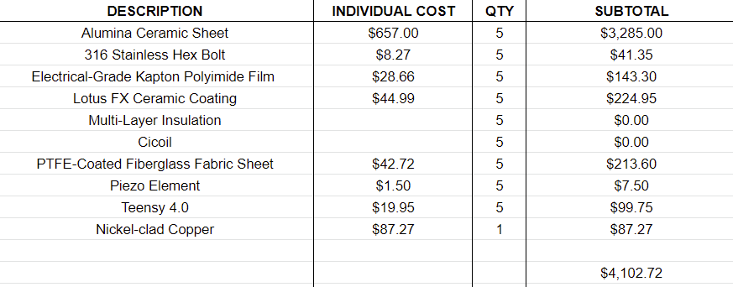
[Logistics]
[Budgeting and Limitations]
AIAA Caltech Student Branch – 18/11/20
Preliminary Design Review – H.O.M.E.S.
Raw Material Costs Est.
4 prototypes without EDS System
1 complete prototype
Costs will increase if a need for iteration arises
Note: Does not include machining or circuit component costs

